Slide 1

Helm - Tutorial

Slide 2
Topics
Helm Overview & features
Helm installation
Helm charts – Install / Upgrade/Rollback
Helm package
Helm repository
Helm Github pages

Slide 3

Current Problems in Deployment
No easy deployment
Hard coded values
Manually track dependencies while deployment
Cannot maintain versions of deployment
Tough to remove objects
Not an easy way to share with others
Cannot resuse part of code snippet

Slide 4
Solution - Helm
Create package of files and easily install/uninstall/rollback package
1
Create templates to avoid hard coding
2
Use hooks to define pre and post dependencies
3
Helm keeps versioning through its releases
4
Store the package in http repository and share repo url
5
Use named templates to define reusable code snippet

Slide 5

Helm – Package manager for kubernetes
Helm is the best way to find, share, and use software built for Kubernetes.
Helm is a powerful tool that simplifies the deployment and management of applications on Kubernetes. It acts as a package manager for Kubernetes, much like apt or yum for Linux, allowing users to define, install, and upgrade even the most complex Kubernetes applications. With Helm, system administrators and developers can streamline their workflows, reduce complexity, and ensure consistency across deployments.

Slide 6

What is Helm ?
Helm helps you manage Kubernetes applications — Helm Charts help you define, install, and upgrade even the most complex Kubernetes application.
Charts are easy to create, version, share, and publish — so start using Helm and stop the copy-and-paste.
Helm is a graduated project in the CNCF and is maintained by the Helm community.

Slide 7
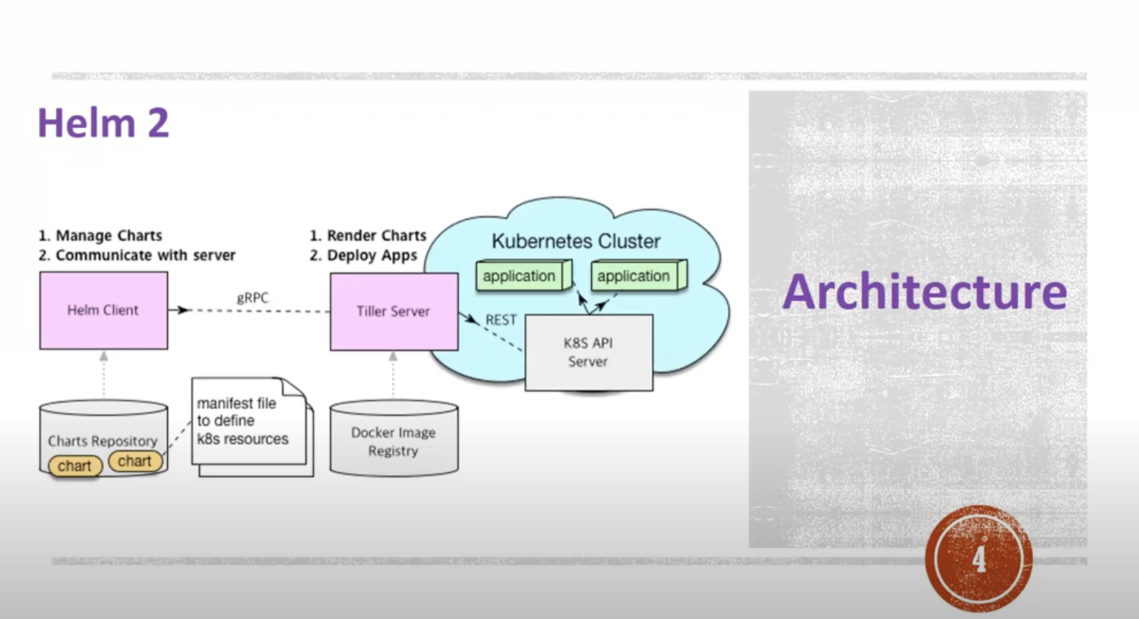
Helm 2 Architecture

Slide 8
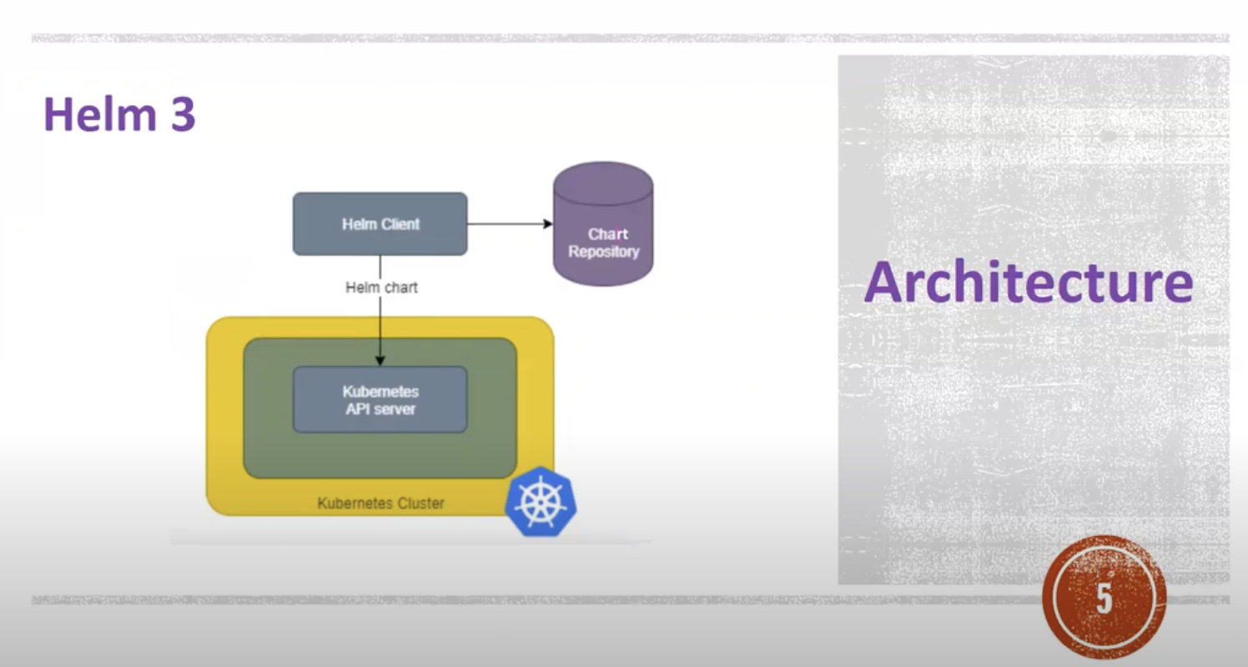
Helm 3 Architecutre

Slide 9
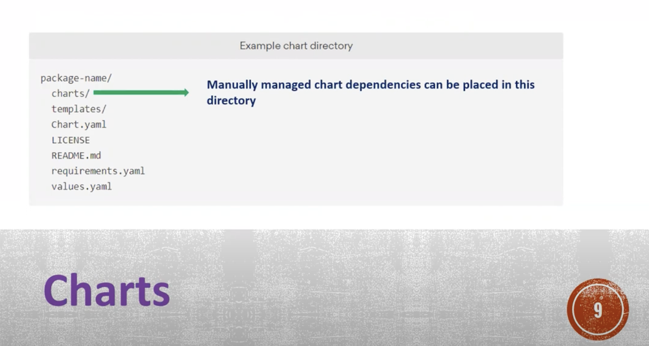
File Structure

Slide 10
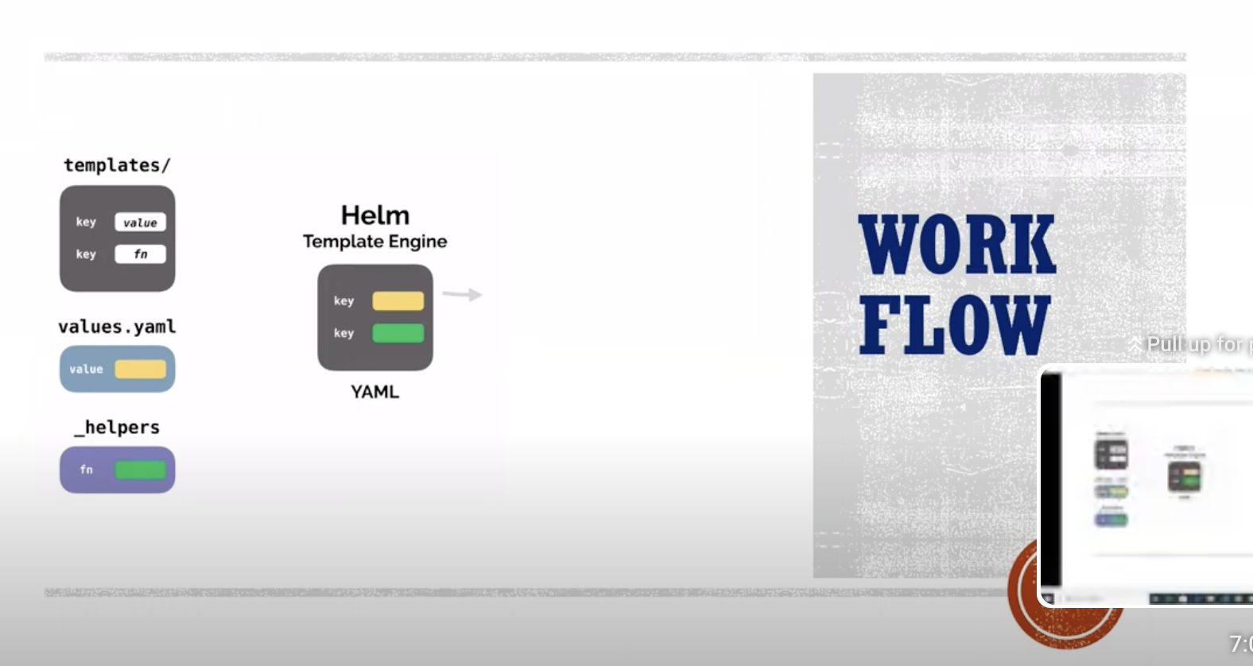
Workflow

Slide 11

Helm Installation
Prerequisites
Install Kuberentes Cluster using Kind
Install kubectl
Installation :
3. Install Helm and check version

Slide 12

Feature of Helm
Package
Package Management: Helm allows users to define, install, and upgrade Kubernetes applications using charts, which can be stored and shared via Helm repositories.
Helm
Templating: Helm uses templates to define Kubernetes manifests, making it easy to customize deployments.
Helm
Versioning: Helm charts support versioning, enabling users to track changes and roll back to previous versions if needed.
Declare
Dependency Management: Charts can declare dependencies, ensuring that all required services are installed and configured correctly.

Slide 13
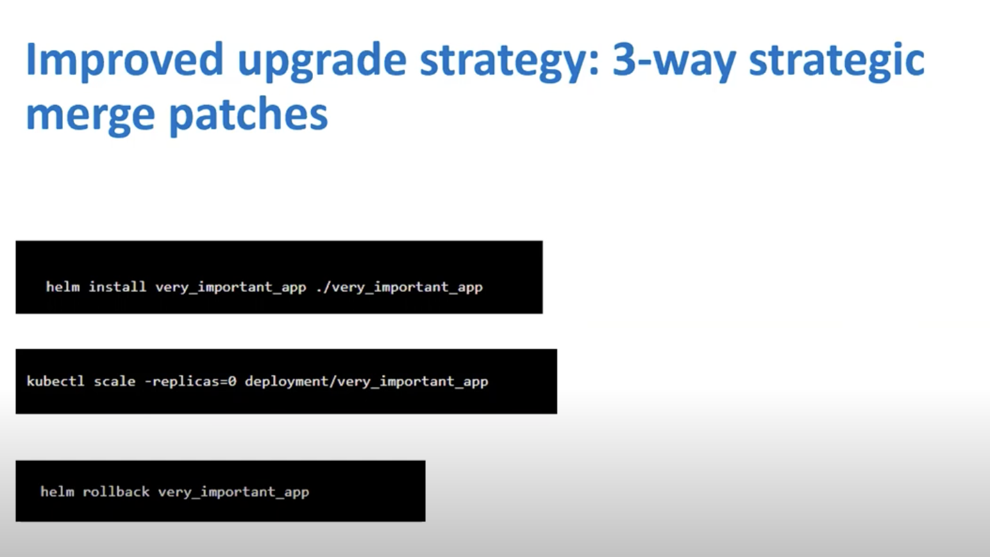

Slide 14
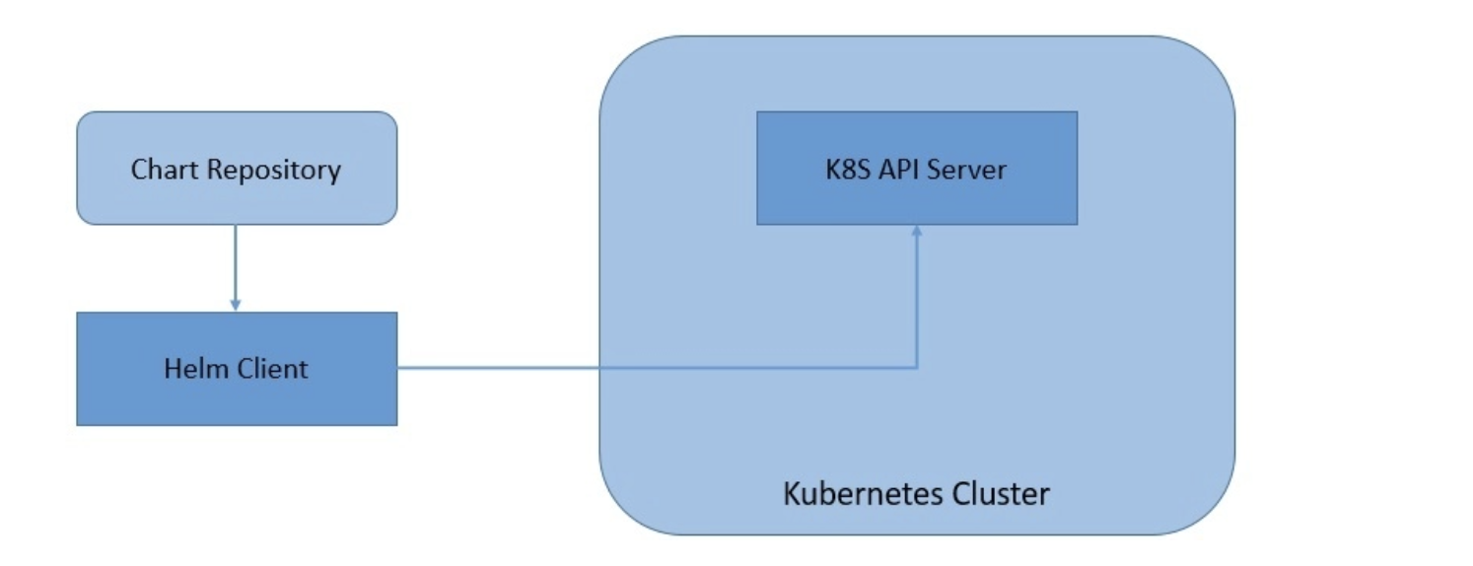
Helm3 Architecture
Helm 3 has moved onto a completely client-only architecture, where the in-cluster server has been removed
The client in Helm 3 works pretty much the same but interacts directly with the Kubernetes API server instead of the Tiller server. This move has simplified the architecture of Helm and allowed it to leverage the Kubernetes user cluster security.

Slide 15
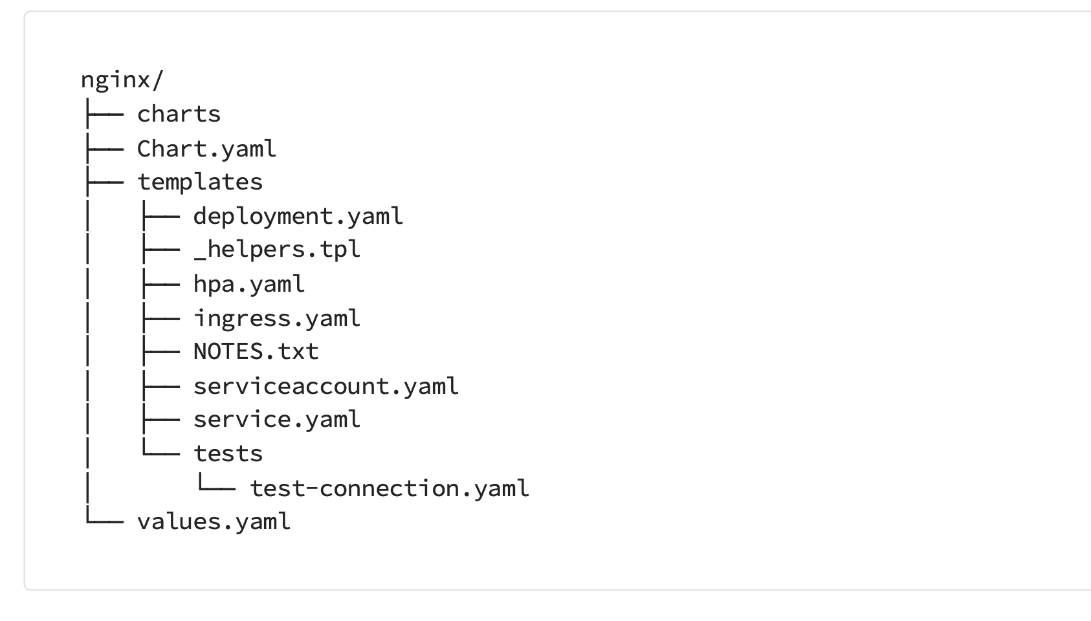
Three big concepts
A Chart is a Helm package. It contains all of the resource definitions necessary to run an application, tool, or service inside of a Kubernetes cluster. Think of it like the Kubernetes equivalent of a Homebrew formula, an Apt dpkg, or a Yum RPM file.
A Repository is the place where charts can be collected and shared. It's like Perl's CPAN archive or the Fedora Package Database, but for Kubernetes packages.
A Release is an instance of a chart running in a Kubernetes cluster. One chart can often be installed many times into the same cluster. And each time it is installed, a new release is created. Consider a MySQL chart. If you want two databases running in your cluster, you can install that chart twice. Each one will have its own release, which will in turn have its own release name.

Slide 16

First chart
Create first helm chart using command:
Helm create firstchart
Below is the chart files/folders created :
root@helm:/home/trainer/helm-chart/firstchart# ll
total 32
drwxr-xr-x 4 root root 4096 Jul 17 12:17 ./
drwxr-xr-x 5 root root 4096 Jul 17 11:46 ../
-rw-r--r-- 1 root root 349 Jul 17 11:25 .helmignore
-rw-r--r-- 1 root root 1147 Jul 17 12:16 Chart.yaml
drwxr-xr-x 2 root root 4096 Jul 17 11:25 charts/
-rw-r--r-- 1 root root 3984 Jul 17 12:17 secondchart-0.1.0.tgz
drwxr-xr-x 3 root root 4096 Jul 17 11:25 templates/
-rw-r--r-- 1 root root 2363 Jul 17 11:40 values.yaml
root@helm:/home/trainer/helm-chart/firstchart#

Slide 17
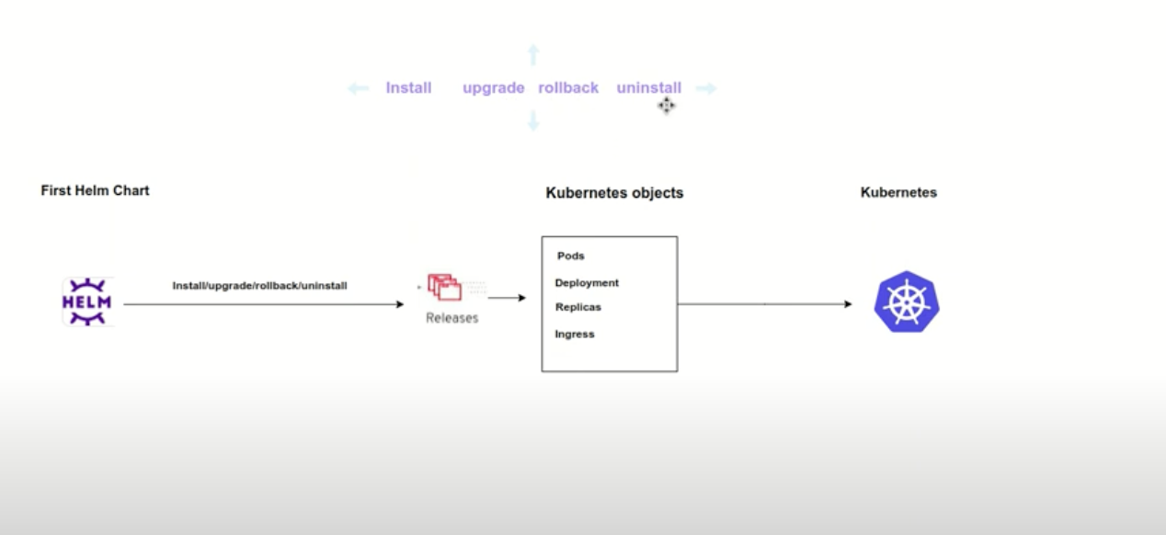
Install/Upgrade/Rollback/Uninstall

Slide 18
Helm package
Package a chart directory into a chart archive. It packages a chart into a versioned chart archive file. If a path is given, this will look at that path for a chart (which must contain a Chart.yaml file) and then package that directory.

Slide 19
Chart Repository
A chart repository is an HTTP server that houses an index.yaml file and optionally some packaged charts. When you're ready to share your charts, the preferred way to do so is by uploading them to a chart repository.
Because a chart repository can be any HTTP server that can serve YAML and tar files and can answer GET requests, you have a plethora of options when it comes down to hosting your own chart repository. For example, you can use a Google Cloud Storage (GCS) bucket, Amazon S3 bucket, GitHub Pages, or even create your own web server.

Slide 20
The chart repository structure
A chart repository consists of packaged charts and a special file called index.yaml which contains an index of all of the charts in the repository. Frequently, the charts that index.yaml describes are also hosted on the same server, as are the provenance files.
For example, the layout of the repository https://example.com/charts might look like this:
charts/ | |- index.yaml | |- alpine-0.1.2.tgz | |- alpine-0.1.2.tgz.prov

Slide 21
Index File
The index file is a yaml file called index.yaml. It contains some metadata about the package, including the contents of a chart's Chart.yaml file. A valid chart repository must have an index file. The index file contains information about each chart in the chart repository. The helm repo index command will generate an index file based on a given local directory that contains packaged charts.
GitHub Pages example
In a similar way you can create charts repository using GitHub Pages.
GitHub allows you to serve static web pages in two different ways:
By configuring a project to serve the contents of its docs/ directory
By configuring a project to serve a particular branch

Slide 22
Helm Dependency
Manage the dependencies of a chart.
Helm charts store their dependencies in 'charts/'. For chart developers, it is often easier to manage dependencies in 'Chart.yaml' which declares all dependencies.
The dependency commands operate on that file, making it easy to synchronize between the desired dependencies and the actual dependencies stored in the 'charts/' directory.
Example :
# Chart.yaml dependencies: -
name: nginx
version: "1.2.3" repository: file://../dependency_chart/nginx

